Slide 1
GEO 3330 Sustainable Urban Transportation
Exercise #2: L Station Ridership Trends
Sage Katwala

Slide 2
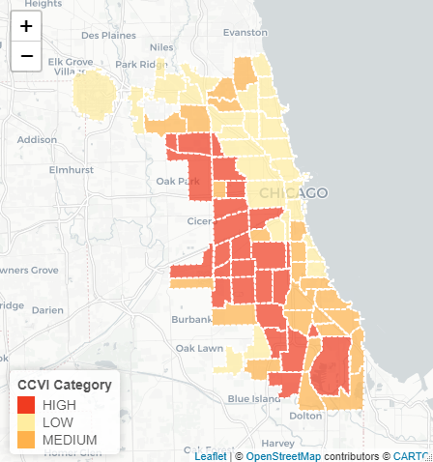
Figure 1 (map of CCVI Scores by Community Area)
Describe here any patterns you see in the map. Use data from the map to describe characteristics of at least one community located within each of the three CCVI categories.
The community areas with the lowest CCVI are located primarily in the north side of Chicago along the lakeshore. Even within this area of the north lakeshore with low CCVI score, the scores follow a similar pattern to the rest of Chicago. Lakeview has a CCVI score of 5.2 and socioeconomic status of 2, and Lincoln park has a CCVI score of 7.3 and socioeconomic status of 3. Then going north to Uptown which also has a CCVI category of Low, the actual CCVI score already goes up to 24 and socioeconomic status of 20, and then rest of the scores like for essential workers (37), mobility ratio (10) are also proportionately higher in comparison to Lakeview and Lincoln Park. Irving Park is also in the Low CCVI category, but the ccvi score is 30, socioeconomic status score is 14, but its essential workers is 62 which is much higher in comparison, and more similar to that of Humboldt Park for example. Humboldt Park is in the High CCVI category with a socioeconomic status score of 59 and essential workers score of 63, only one higher than Irving Park. The community areas with a high CCVI category are mostly located on the West side of Chicago and South/Southwest. The community areas of Lower West Side and Near West Side are right next to each other, but the NWS has a CCVI score of 20, socioeconomic status score of 30, and mobility ratio of 15, while LWS has a CCVI score of 48.9, a socioeconomic score of 38 and mobility ratio score of 50. All the other scores of LWS are much higher than its adjacent community area which just goes to show that location is not the only factor that effects these things.

Slide 3
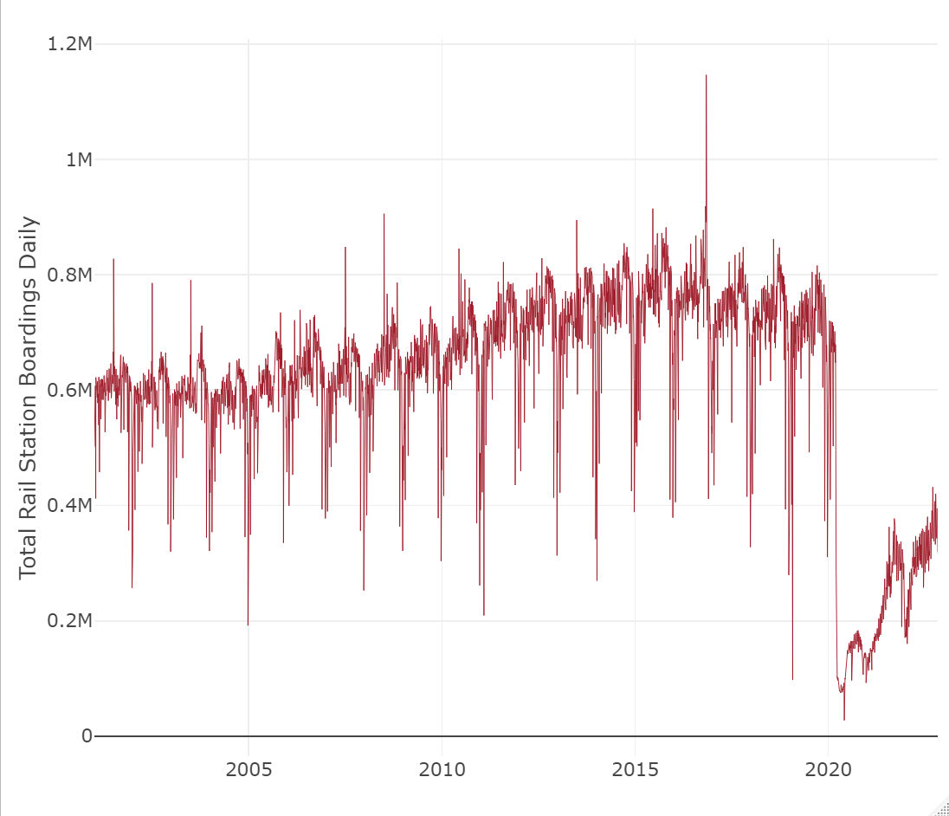
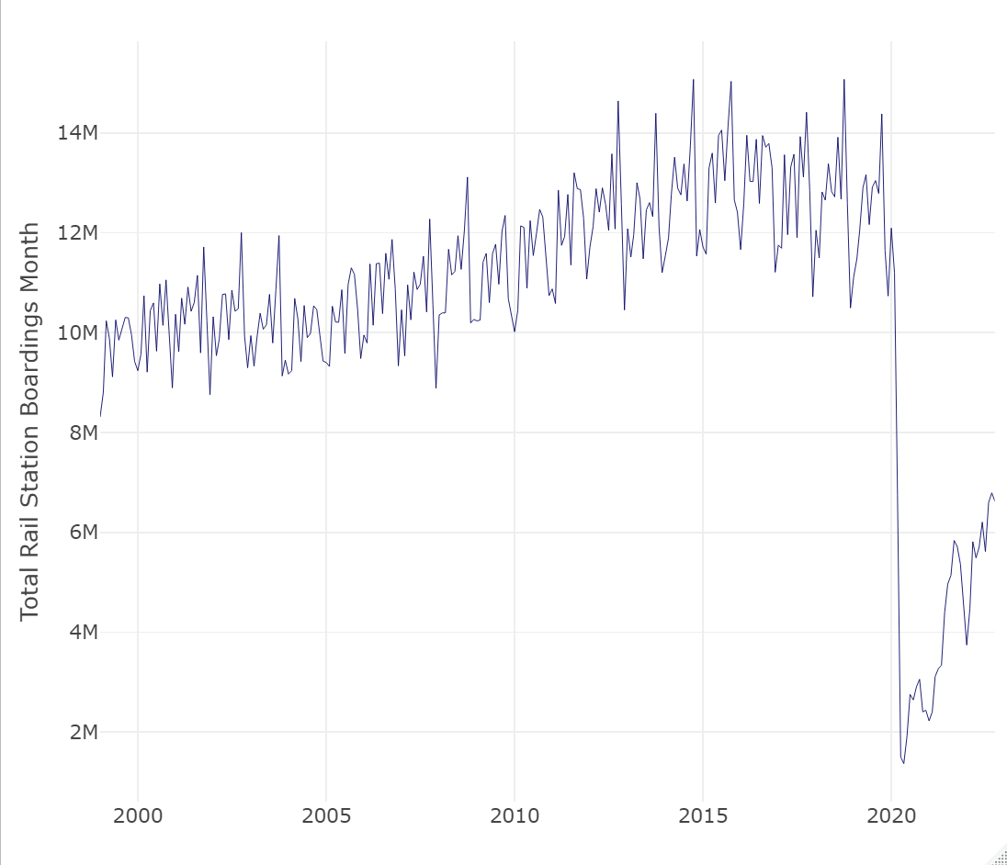
Figure 2 & 3
Describe patterns in rail boardings between 1999 and 2022. What do you think explains some of the cyclical variations in the data? What other factors may explain ridership over this period? Draw from the daily ridership plot to characterize ridership trends during the pandemic.
Some of the factors that might affect the cyclical variations each year could be weather or students coming back to campus/kids going to school. There could also be more people from the suburbs visiting in the summer but I don’t think that would affect much. Weather might affect the reliability of the trains and also people’s willingness to stand outside.
According to the monthly ridership, the ridership tends to peak around October, and dip in December, but for the daily ridership graph it seems to peak in either June or July and sometimes October, but it also tends to dip in December like the monthly ridership graph does. People leaving for the holidays. The dips during the winter months (Nov-Feb) are the most consistent within and between each graph, so weather as well as maybe people leaving for holidays are probably what’s most responsible for the cyclical ridership trends each year.
During the pandemic, June 2020 has the lowest dip. The cyclical drip during the winter continues both winters (2020-2021 and 2021-2022). After each dip the ridership slowly increases and then dips again until around April 2022 where it’s less erratic and more of a steady increase, but still only gets to about half of what the average seemed like before.

Slide 4
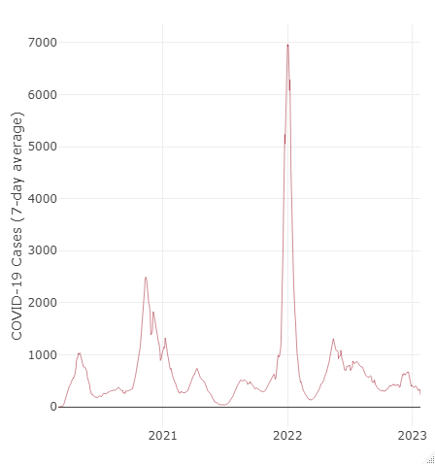
Figure 4.
GEO 3330 Sustainable Urban Transportation
Exercise #2: L Station Ridership Trends
Are the waves and phases of the pandemic evident? Compare these pandemic phases to ridership trends over the same period. Do they appear to be related?
The waves of the pandemic are definitely evident in the graph. We can see how in early 2020 cases rose, things shut down, and cases decreased, and then increased again each winter and decreased each time restrictions came back. But the cyclical trends of ridership are basically the opposite of covid case trends. When covid cases are at a peak such as the beginning of the pandemic or during winter, the ridership decreased. And more recently as cases continue to decrease slowly, ridership is increasingly slowly.

Slide 5
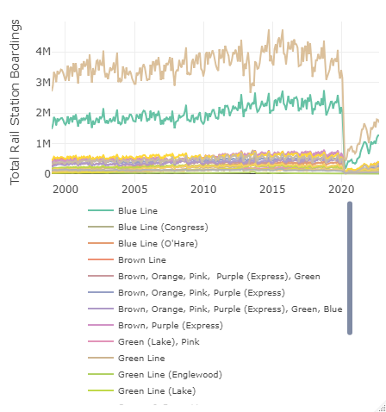
How does ridership vary with respect to station CCVI and line?
All of the lines seem to share a similar shape of graph and share the pattern, but the two blue line trendlines are just higher and more extreme than all the rest. Possibly because the blue line is in the community areas with low CCVI and the blue line also just travels to more places, where stations that service lines like the brown, orange, pink, and green lines center around the loop, so it’s possible that people just have more options. And the stations are closer together so the ridership per station is more dispersed, where the blue line services much of the city that rides the CTA a lot and the stations are more spread out so the ridership will be more concentrated per station.
The high CCVI has more ridership than medium although not by a lot in comparison to the low CCVI. High CCVI having more ridership than medium makes sense because the people with higher vulnerability probably have less access to other kinds of transportation. But this pattern doesn’t continue to low CCVI which has much higher ridership than both high and medium. This still makes sense because it’s the more wealthy areas that the CTA was built for and is still where most of the CTA lines run (loop and north), and it’s the more vulnerable areas that are still underserved. But also, the places with CTA access might be more likely to develop and be gentrified, and the low CCVI areas are also where university campuses are and where there are many students who use the CTA but also the campuses also contribute to gentrifying the neighborhoods.
GEO 3330 Sustainable Urban Transportation
Exercise #2: L Station Ridership Trends

Slide 6
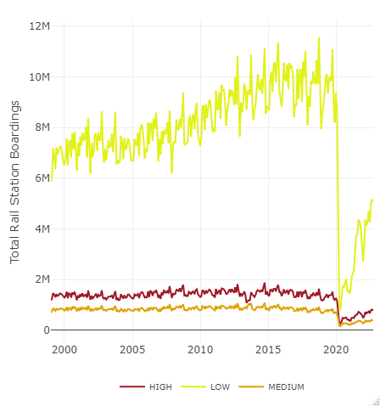
Summarize some potential short- and longer-term implications the pandemic has had on sustainable transportation and public transit ridership?
It has made public transit less safe and less reliable.
And from both these graphs and the pandemic as a whole, it’s shown us how wide the wealth disparity and disparity in vulnerability has grown, and opened a lot of people’s eyes to injustice and inequality and the failures of capitalism and the need for a stronger social safety net which public transit can be a part of fixing that
The pandemic has also changed a lot of people’s views on working, and this may change commute patterns which would affect what kind of role public transit plays and where the needs are
What strategies do you propose to help return transit to pre-pandemic levels?
In some ways you just can’t return to quite the same levels because of the increase of people working from home. But really I think people just want to feel safe and that they can rely on public transit to get them to where they’re going especially after two years of being told to be scared of being in public.
Paying CTA workers fairly so things that be better maintained and there can be more trains running more often
Increase frequency of trains and buses which would make them more reliable and also less crowded
Especially increase reliability of buses. The buses are great in the sense of ho far their reach is, but they’re so unreliable. Or at least fix the apps or bus trackers.
Kick cars out of bus lanes
Stop shutting down lines for no reason especially those that go to airports
Decrease the cost or make it more accessible
Make mixed mode public transit easier (safe and well maintained bike racks at CTA stations)

